Slide 1


Ameer Ashraf
8/16/2023

Slide 2

Outline
Executive Summary
Introduction
Methodology
Results
Conclusion
Appendix

Slide 3
Executive Summary
Summary of methodologies
Data Collection using web scraping and SpaceX API;
• Exploratory Data Analysis (EDA), including data wrangling, data visualization and interactive visual analytics;
• Machine Learning Prediction.
Summary of all results
• All data collected came from public sources
• EDA helped identify the features best ft to predict a successful landing
• Machine Learning helped show which model to apply for the best possible success rate

Slide 4
Introduction
Project background and context
The era of commercial space has arrived, and there are several companies that are making space travel affordable for everyone. Perhaps the most successful of them is SpaceX, and one of the reasons is that their rocket launch is relatively inexpensive.
SpaceX advertises Falcon 9 rocket launches on its website, with a cost of 62 million dollars; other providers cost upward of 165 million dollars each, much of the savings is because SpaceX can reuse the first stage.
Therefore, we will predict if the Falcon 9 first stage will land successfully. If we can determine if the first stage will land, we can determine the cost of a launch. This information can be used if an alternate company wants to bid against SpaceX for a rocket launch.
Problems you want to find answers
- Correlations between each rocket variables and successful landing rate
- Conditions to get the best results and ensure the best successful landing rate

Slide 5

Section 1

Slide 6
Methodology
Executive Summary
Data collection methodology:
Data was collected using SpaceX REST API and Web scraping from Wikipedia
Perform data wrangling
Data was processed by implementing the one-hot encoding method for categorial features
Perform exploratory data analysis (EDA) using visualization and SQL
Perform interactive visual analytics using Folium and Plotly Dash
Perform predictive analysis using classification models
How to build, tune, evaluate classification models

Slide 7
Data Collection
Describe how data sets were collected.
Data sets were collected from Space X API (https://api.spacexdata.com/v4/rockets/) and from Wikipedia
(https://en.wikipedia.org/wiki/List_of_Falcon/_9/_and_Falcon_Heavy_launches), using web scraping technics.

Slide 8
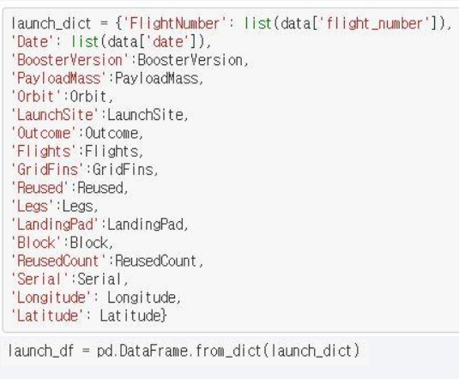
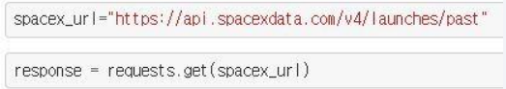
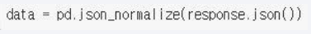
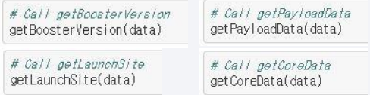
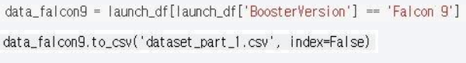
Data Collection – SpaceX API
4.Combining the columns into a dictionary to create data frame
5.Filtering dataframe and exporting to a CSV
1.Requesting rocket launch data from SpaceX API
.Converting Response to a JSON file
3.Using custom functions to clean data

Slide 9
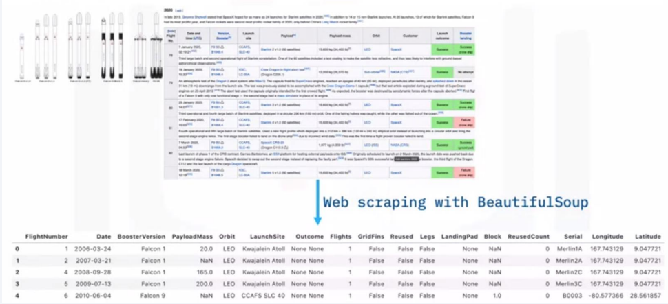
Data Collection - Scraping
The SpaceX launches can be found on Wikipedia
It can be downloaded then using beautiful soup can be extracted

Slide 10
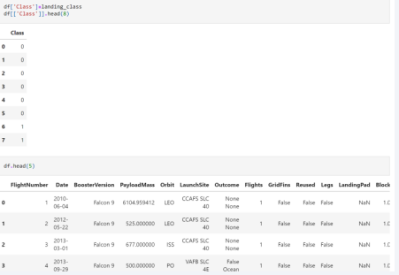
Data Wrangling
Describe how data were processed
Using EDA, we summarized the data into categories then we created
outcome tables

Slide 11
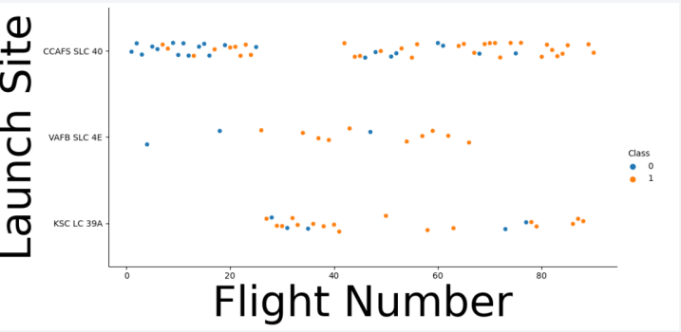
EDA with Data Visualization
• To present the data scatterplots and bar graphs were used

Slide 12
EDA with SQL
• SQL queries performed:
• Unique names of launch sites
• Top 5 launch sites with names that start with ‘CCA’
• Names and booster weighing between 400 and 600 kg that successfully landed
• Names of the booster with max payloads
• Failed landing outcomes of 2015

Slide 13
Build an Interactive Map with Folium
• Objects created and added to a folium map:
○ Markers that show all launch sites on a map
○ Markers that show the success/failed launches for each site on the map
○ Lines that show the distances between a launch site to its proximities
• By adding these objects, following geographical patterns about launch sites are found:
○ Are launch sites in close proximity to railways? Yes
○ Are launch sites in close proximity to highways? Yes
○ Are launch sites in close proximity to coastline? Yes
○ Do launch sites keep certain distance away from cities? Yes

Slide 14
Build a Dashboard with Plotly Dash
The dashboard application contains a pie chart and a scatter point chart.
○ Pie chart
■ For showing total success launches by sites
■ This chart can be selected to indicate a successful landing distribution across all launch sites or to indicate the success rate of individual launch sites.
○ Scatter chart
■ For showing the relationship between Outcomes and Payload mass(Kg) by different boosters
■ Has 2 inputs: All sites/individual site & Payload mass on a slider between 0 and 10000 kg
■ This chart helps determine how success depends on the launch point, payload mass, and booster version categories.

Slide 15
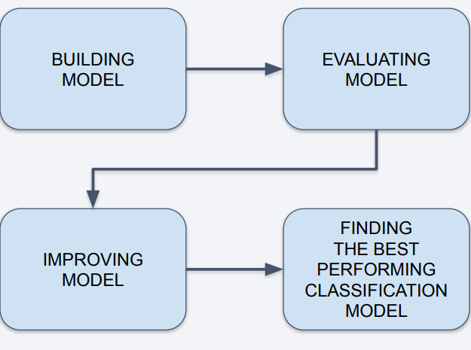
Predictive Analysis (Classification)
• Perform exploratory Data Analysis
and determine Training Labels
○ Create a column for the class
○ Standardize the data
○ Split into training data and test
data
• Find best Hyperparameter for SVM,
Classification Trees and Logistic
Regression
○ Find the method performs best
using test data

Slide 16
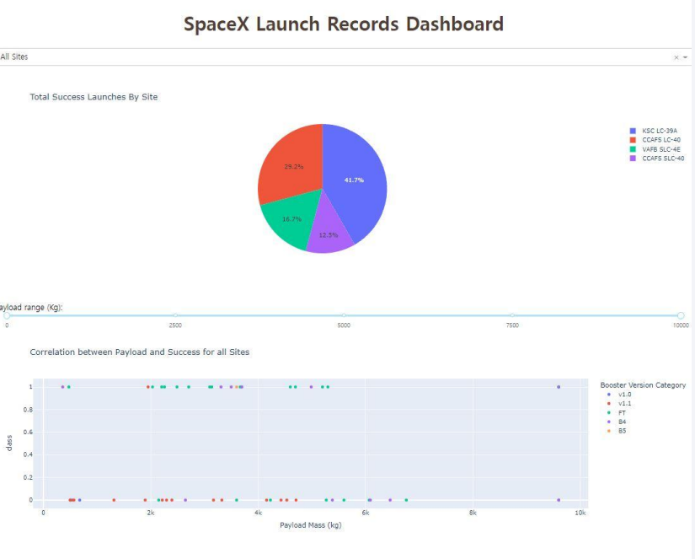
Results
• The right screenshot is a preview of the Dashboard with Plotly Dash.
• The results of EDA with visualization, EDA with SQL, Interactive Map with Folium, and Interactive Dashboard will be shown in the next slides.
• Comparing the accuracy of the four methods, all return the same accuracy of about 83% for test data.

Slide 17

Section 2

Slide 18
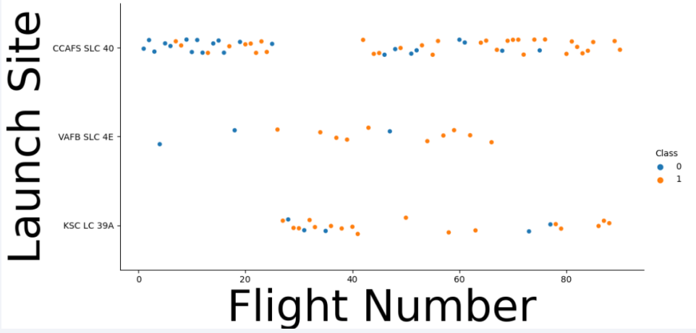
Flight Number vs. Launch Site
Looking at the data we can see that CCAF5 SLC 40 is the best place to launch because of the high success rate
We can also see the overall success rate increase over time

Slide 19
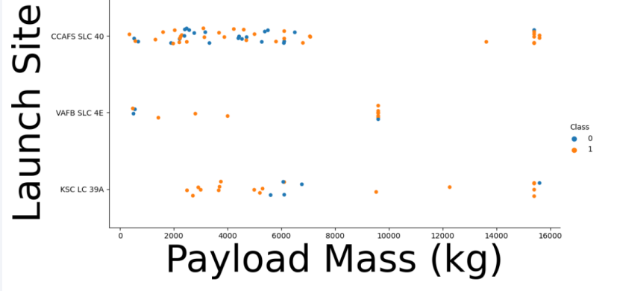
Payload vs. Launch Site
• The data shows that payloads at 9000 kg and under have a high success rate overall

Slide 20
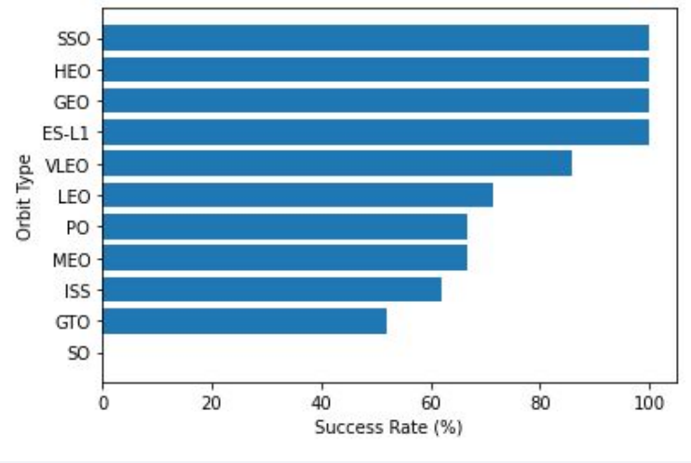
Success Rate vs. Orbit Type
• Orbit types SSO, HEO, GEO, and ES-L1 have the highest success rates (100%).
• On the other hand, the success rate of orbit type GTO is only 50%, and it is the lowest except for type SO, which recorded failure in a single attempt.

Slide 21
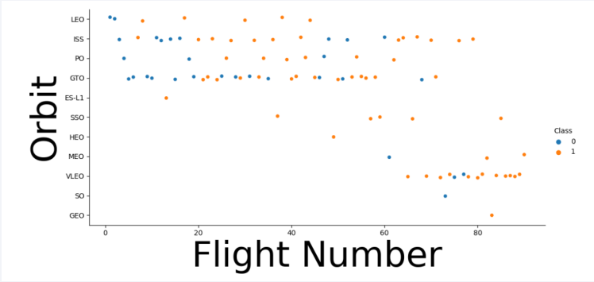
Flight Number vs. Orbit Type
• Show a scatter point of Flight number vs. Orbit type
• Overall, you can see that success rate improved and that VLEO seems to be the new Orbit that SpaceX is going for

Slide 22
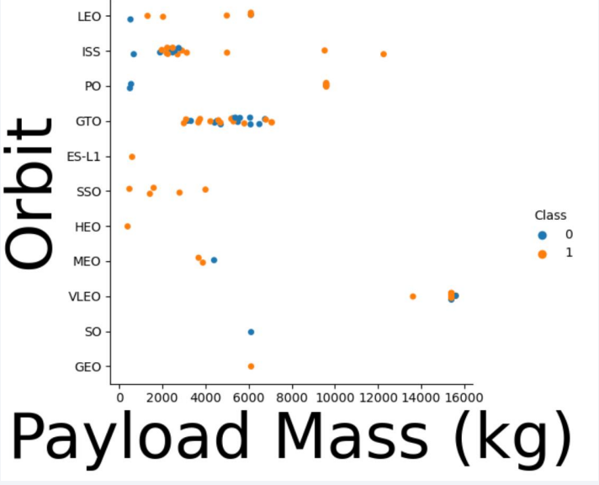
Payload vs. Orbit Type
Show a scatter point of payload vs. orbit type
• Payload at GTO has no real affect and there is too little data on SO and GEO

Slide 23
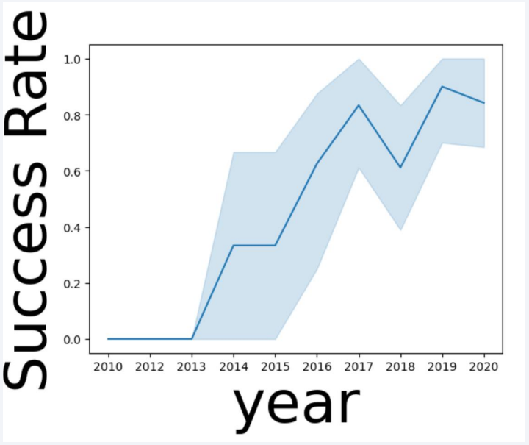
Launch Success Yearly Trend
Show a line chart of yearly average success rate
• There seemed to be a continuous success rate until 2018 and halfway through 2019

Slide 24
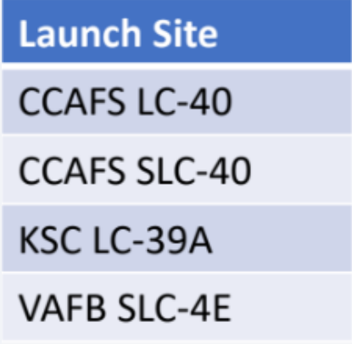
All Launch Site Names
• Find the names of the unique launch sites
• Using the “launch site” value from the data set it shows you that there are 4 launch sites

Slide 25
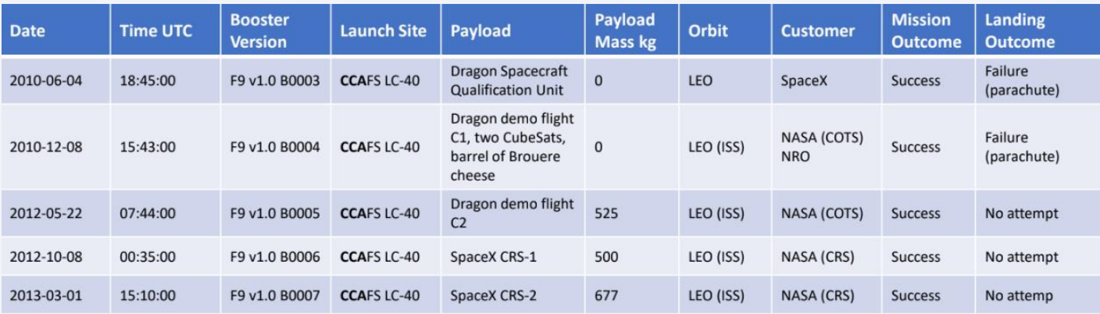
Launch Site Names Begin with 'CCA'
• Find 5 records where launch sites begin with `CCA`

Slide 26
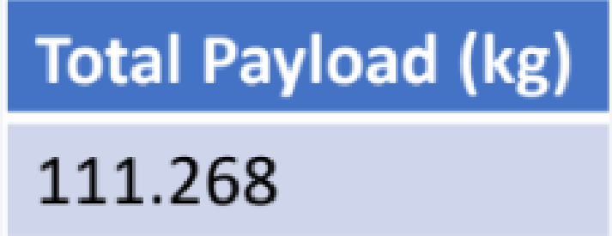
Total Payload Mass
• Calculate the total payload carried by boosters from NASA
• Total payload was calculated by summing all payloads with their code containing ‘CRS’ which is the code for NASA

Slide 27
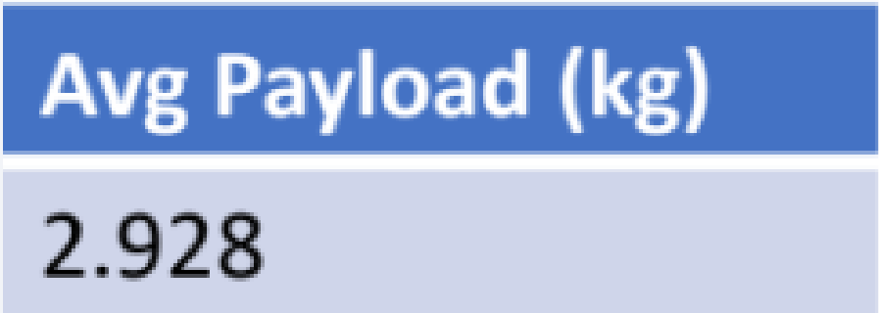
Average Payload Mass by F9 v1.1
• Calculate the average payload mass carried by booster version F9 v1.1
• After filtering the data by booster version, the average payload mass obtained is 2,928 kg.

Slide 28
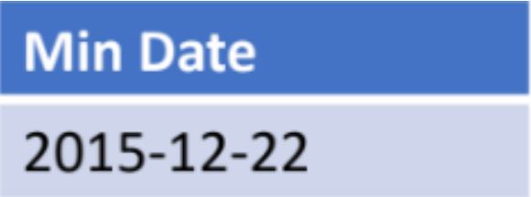
First Successful Ground Landing Date
• Find the dates of the first successful landing outcome on ground pad
• After filtering the data on ground pad, the first successful landing was on 12-22-2015

Slide 29
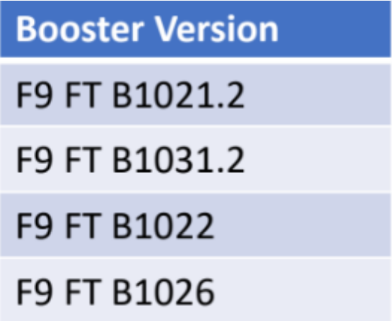
Successful Drone Ship Landing with Payload between 4000 and 6000
• List the names of boosters which have successfully landed on drone ship and had payload mass greater than 4000 but less than 6000
• After filtering for distinct booster versions, the 4 booster versions used where these

Slide 30
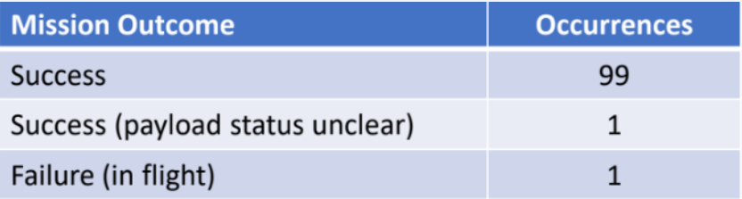
Total Number of Successful and Failure Mission Outcomes
• Calculate the total number of successful and failure mission outcomes
• After grouping mission outcomes and counting records produces this summary

Slide 31
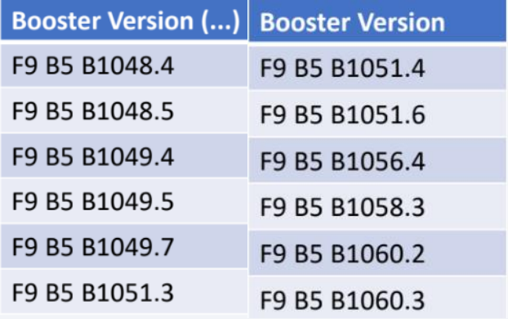
Boosters Carried Maximum Payload
• List the names of the booster which have carried the maximum payload mass
• These are the boosters that have had the maximum payload according to the data

Slide 32
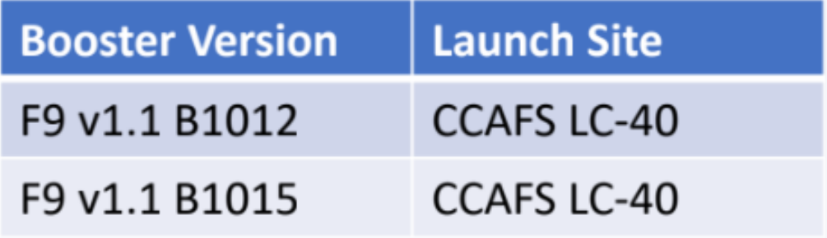
2015 Launch Records
• List the failed landing outcomes in drone ship, their booster versions, and launch site names for in year 2015
• For failed landing outcomes in drone ships there were only 2

Slide 33
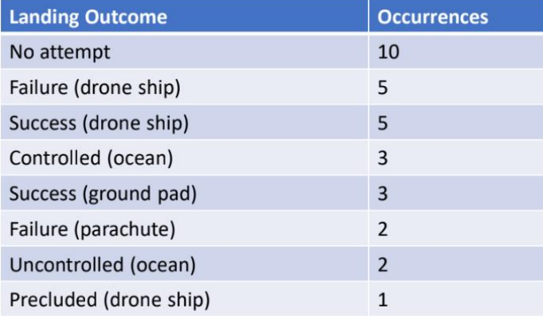
Rank Landing Outcomes Between 2010-06-04 and 2017-03-20
• Rank the count of landing outcomes (such as Failure (drone ship) or Success (ground pad)) between the date 2010-06-04 and 2017-03-20, in descending order
• Ranking: there were 5 Failure for drone ships which of the two datatypes we want to see its the current king for occurrences compared to the success of the ground pad at 3 times

Slide 34

Section 3

Slide 35
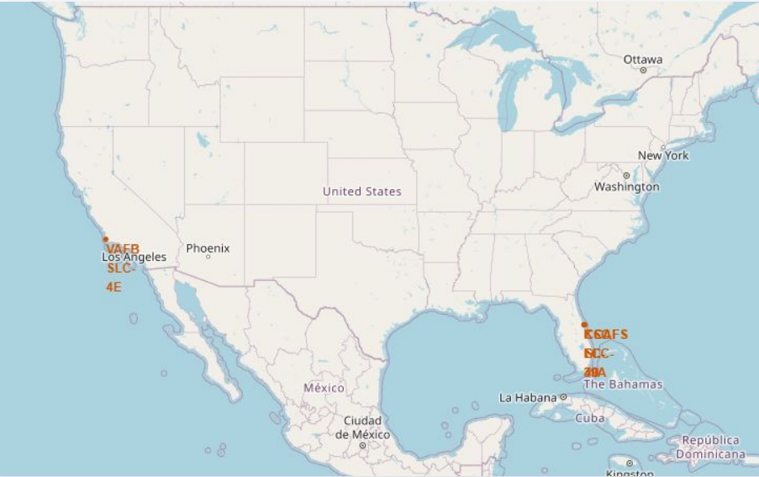
Launch Sites
• The map on the right shows all SpaceX launch sites, and the right map also shows that all launch sites are in the United States.
• As can be seen on the map, all launch sites are near the coast.

Slide 36
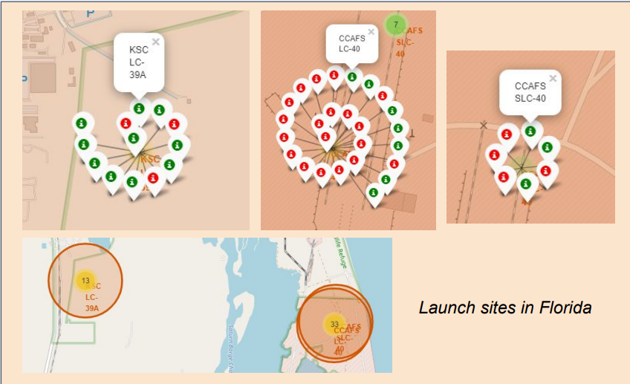
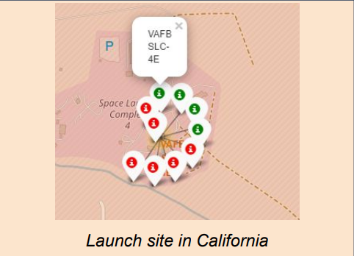
Color-labeled Launch Outcomes
By clicking on the marker clusters, successful landing (green) or failed landing (red) are displayed.

Slide 37
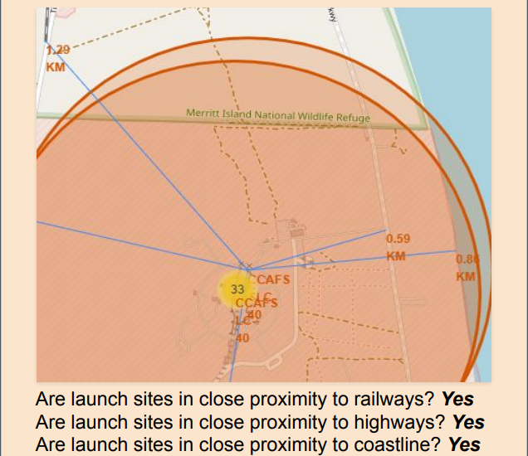
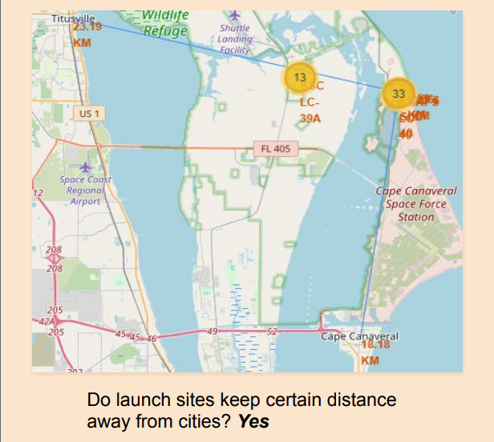
<Folium Map Screenshot 3>
• It can be found that the launch site is close to railways and highways for transportation of equipment or personnel and is also close to coastline and relatively far from the cities so that launch failure does not pose a threat.

Slide 38

Section 4

Slide 39
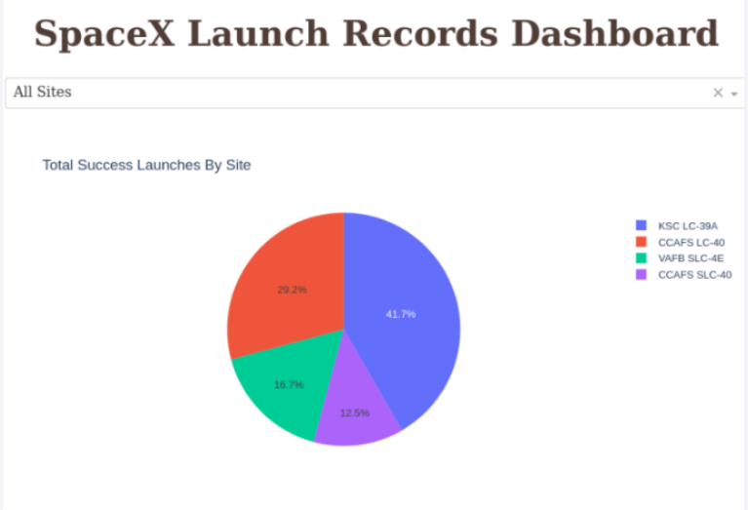
Site Launch success rate
KSC LC-39A has the highest success rate

Slide 40
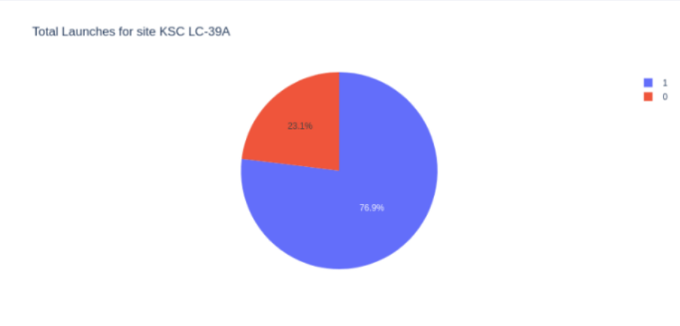
KSC LC-39A Success rate
76.9% of launches at KSC LC-39A were successful

Slide 41
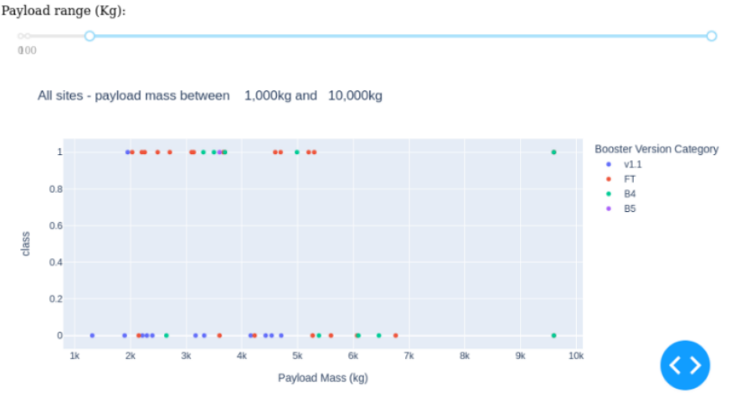
Payload vs Launch Outcome
Payloads under 6,000Kg have the highest success rate but after 7,000Kg there isn’t enough launches to predict the risk of the launch

Slide 42

Section 5

Slide 43
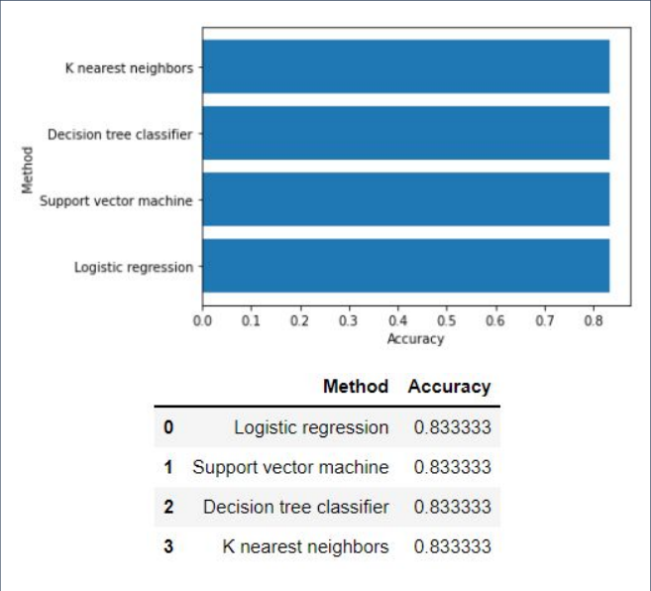
Classification Accuracy
• It should be noted that the test size was small at 18.
In the test set, the accuracy of all models was virtually the same at 83.33%.
• Therefore, more data is needed to determine the optimal model.

Slide 44
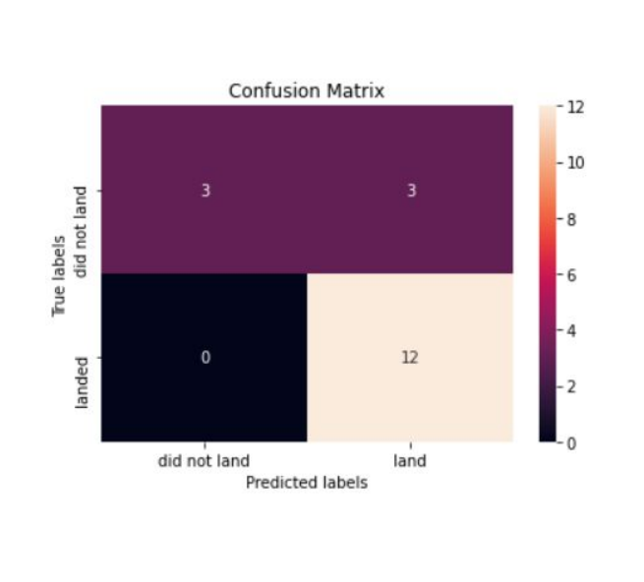
Confusion Matrix
• The confusion matrix is the same for all models because all models performed the same for the test set.
• The models predicted 12 successful landings when the true label was successful and 3 failed landings when the true label was failure. But there were also 3 predictions that said successful landings when the true label was failure (false positive).
• Overall, these models predict successful landings.

Slide 45
Conclusions
• As the number of flights increased, the success rate increased, and recently it has exceeded 80%.
• Orbital types SSO, HEO, GEO, and ES-L1 have the highest success rate (100%).
• The launch site is close to railways, highways, and coastline, but far from cities.
• KSLC-39A has the highest number of launch successes and the highest success rate among all sites.
• The launch success rate of low weighted payloads is higher than that of heavy weighted payloads.
• In this dataset, all models have the same accuracy (83.33%), but it seems that more data is needed to determine the optimal model due to the small data size.

Slide 46
Appendix
• First few images were taken from the section explanation videos from the capstone final projects week 1 and 2

Slide 47


